Slide 1
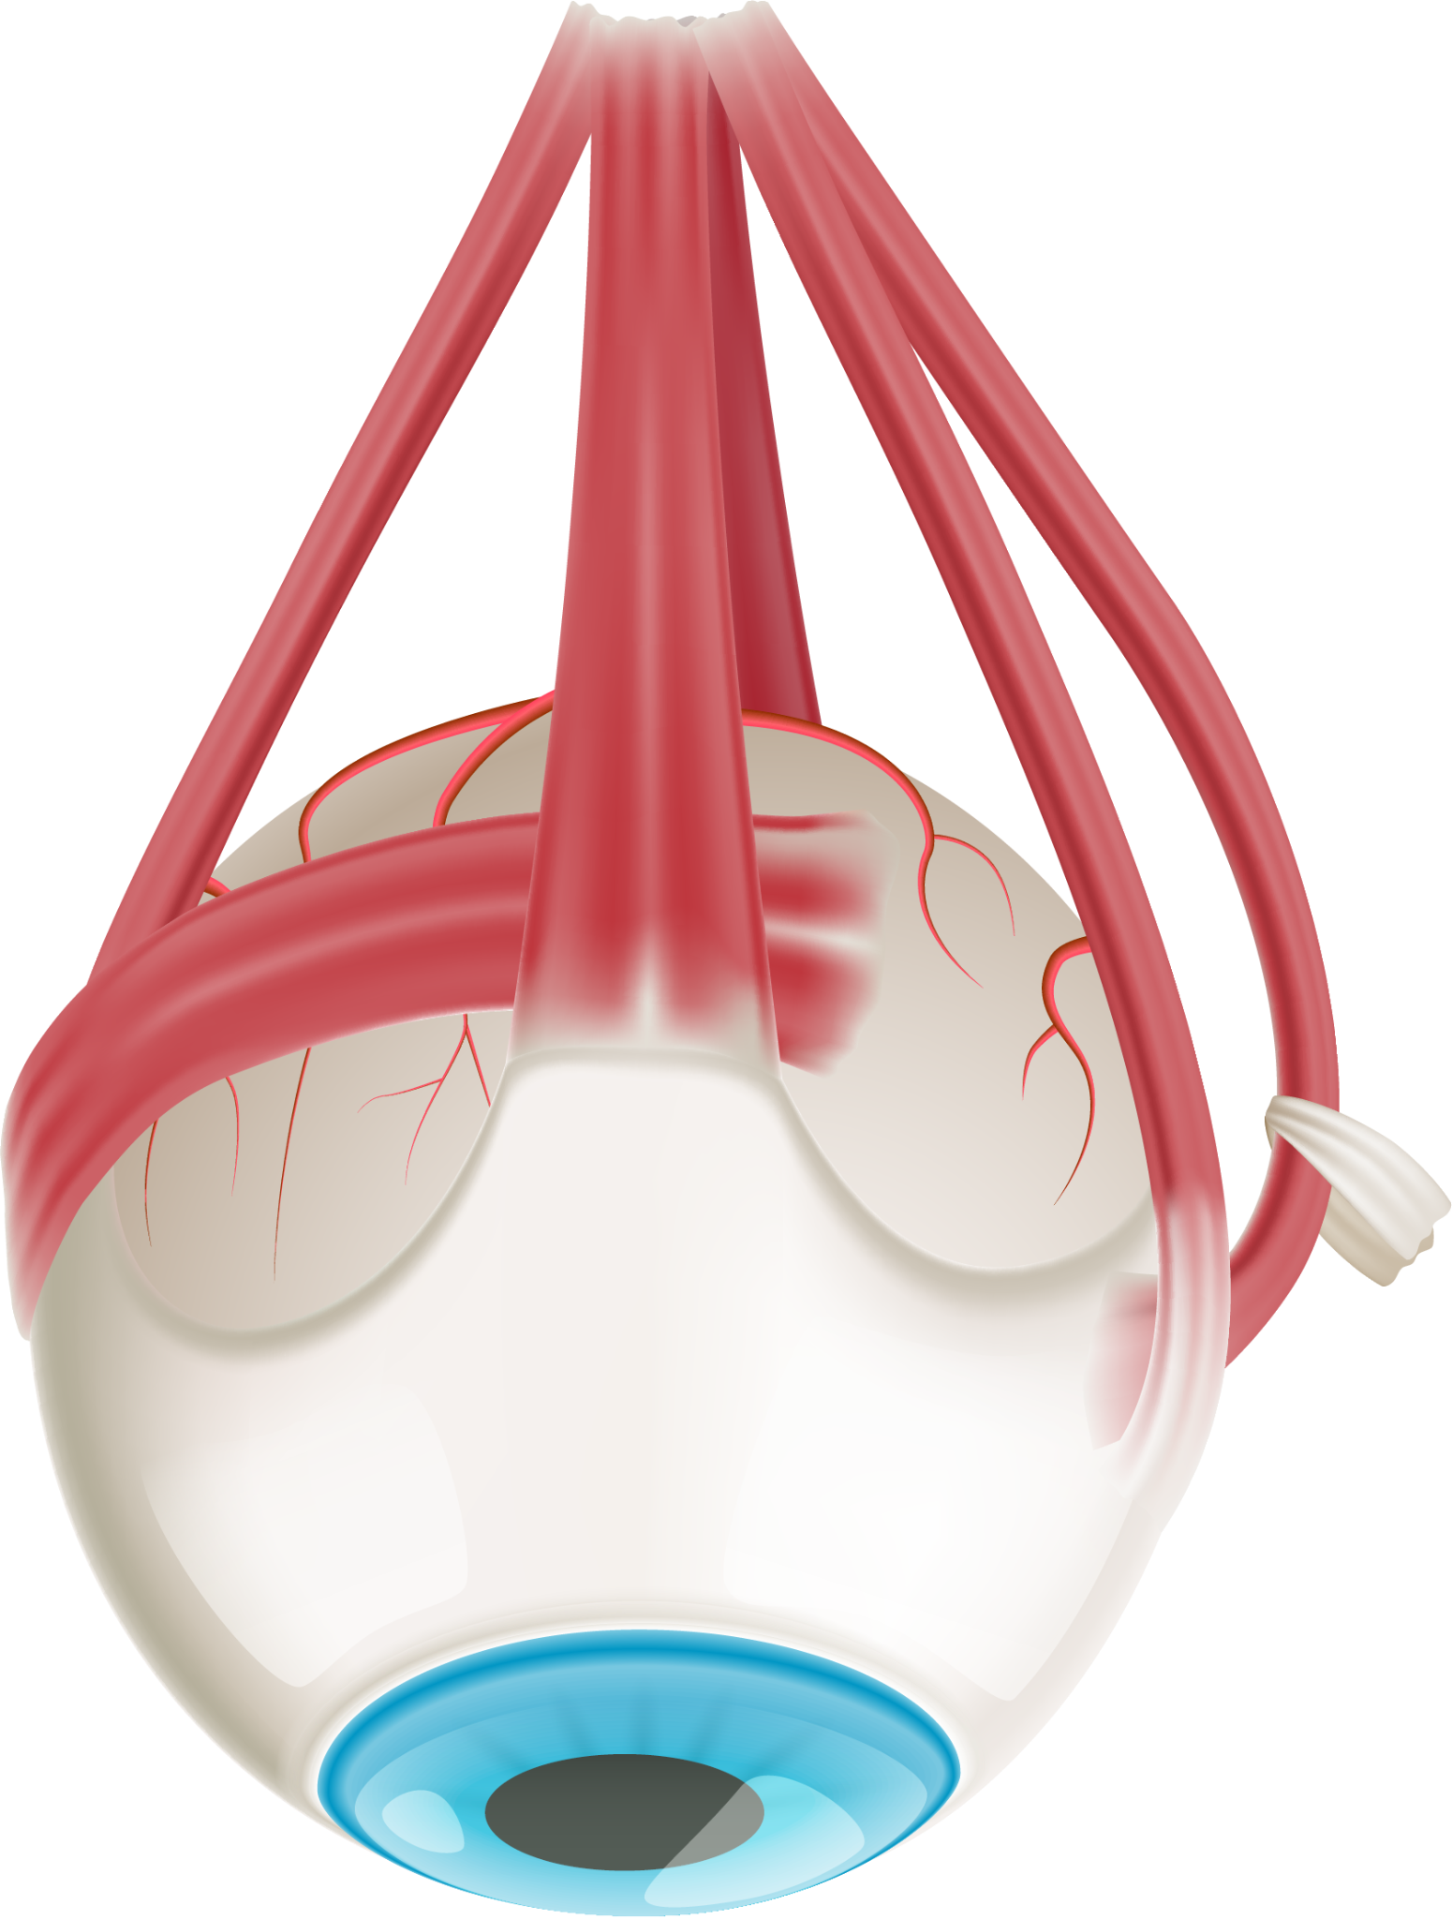
The Power of Positive Experiences: Patient Satisfaction in Healthcare
Healthcare Patient Satisfaction - Data Collection: https://www.kaggle.com/datasets/kaggleprollc/healthcare-patient-satisfaction-data-collection
Group 2 – Atchi, Gopi, Sumanth & Naresh

Slide 2
When do you derive Satisfaction ?
Notes:
Trying to get the attention of the audience

Slide 3
"Have you ever wondered why some healthcare experiences leave a lasting positive impression, while others may fall short of our expectations?"

Slide 4
Introduction to Dataset
Medicare
HCAHPS: The HCAHPS (Hospital Consumer Assessment of Healthcare Providers and Systems) survey is the first national, standardized, publicly reported survey of patient’s perspectives of hospital care
Hospital
CMS
Medicaid
Annually
Goals of Survey
Designed to produce data about patients' perspectives of care
Public reporting of the survey results creates new incentives for hospitals to improve quality of care
Enhance accountability in health care by increasing transparency of the quality of hospital care provided in return for the public investment
Notes:
In the U.S., every hospital that receives payments from Medicare and Medicaid is mandated to provide quality data to The Centers for Medicare and Medicaid Services (CMS) annually. This data helps gauge patient satisfaction levels across the country. While overall hospital scores can be influenced by the quality of customer services, there may also be variations in satisfaction based on the type of hospital or its location.
HCAHPS: The HCAHPS (Hospital Consumer Assessment of Healthcare Providers and Systems) survey is the first national, standardized, publicly reported survey of patient’s perspectives of hospital care
Three broad goals have shaped HCAHPS. First, the survey is
Designed to produce data about patients' perspectives of care that allow objective and meaningful comparisons of hospitals on topics that are important to consumers.
Public reporting of the survey results creates new incentives for hospitals to improve quality of care.
Public reporting serves to enhance accountability in health care by increasing transparency of the quality of hospital care provided in return for the public investment.

Slide 5
The Reason
WHY?
Patient-Centric Focus
Strategic Decision-Making
Informed Patients
Geographical Insights
Unique Dataset

Slide 6

The Journey
We are exploring a comprehensive dataset on patient satisfaction within the healthcare system.
Patient satisfaction goes beyond survey metrics; it reflects the human experience in healthcare, involving interactions, empathy, and the impact of services on individual lives.
"What if we could transform patient satisfaction from a measure on a survey to a genuine feeling of comfort, trust, and confidence in healthcare providers?"

Slide 7








The Journey
Data Understanding: Understanding the 5 years of data from 2016-2020 and its key columns such as Hospital details, Hospital Ratings, Patient Survey ratings, and other parameters and their description
Data Loading: The data of each year to be merged as a single file
Data Transforming: To attain a single data frame, we need to ensure all the identical columns in the year should have the same datatype and perform data cleaning tasks for columns
Data Analysis: Exploratory Data Analysis on the data to find the insights and patterns- which helps to understand the trends
Data Visualization: To gain insights from the data over the years

Slide 8
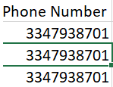

Challenges
Combining data – The data is year-wise like 2016, 2017… 2020, so used R to combine the data
For the phone number column in the 2016 data, we have plain numbers whereas in 2019 we have non-numerics in the data - To overcome we have used the regex function in r to make the data uniform across all.
For Mapping the city-level data in the visualization, we don’t have coordinates in the dataset, so we have taken external data sources called US cities and then merged the data and taken coordinates then plotted the hospitals distribution in the United States
Understanding the different columns to feature for statistical modeling and perform the hypothesis testing – We have taken the prominent columns to perform the statistical modeling

Slide 9
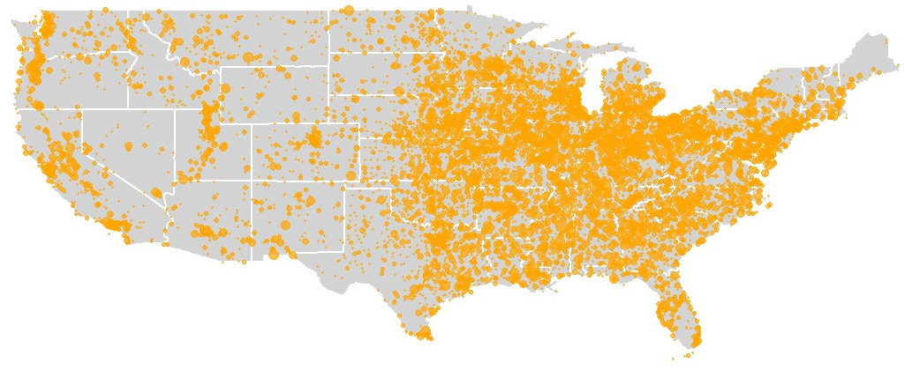
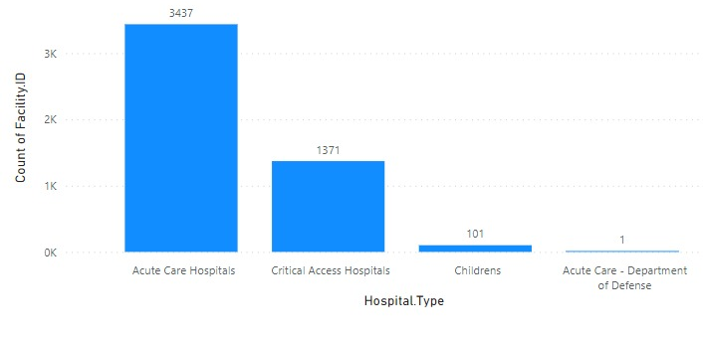
Exploratory Data Analysis
The Geographical Insight
The type of hospitals
Factors for the difference
Population Density
Economic Factors
Healthcare Policy
Educational and Research Institutions
Demographic Factors
Acute Care Hospitals
Critical Access Hospitals
Children Hospitals
Acute care – Department of defense
Notes:
The distribution of hospitals across different regions of the United States can be influenced by various factors, and it's important to note that the distribution of hospitals is complex and influenced by a combination of historical, economic, demographic, and geographic factors. Here are some potential reasons why there might be more hospitals in the eastern part of the USA

Slide 10
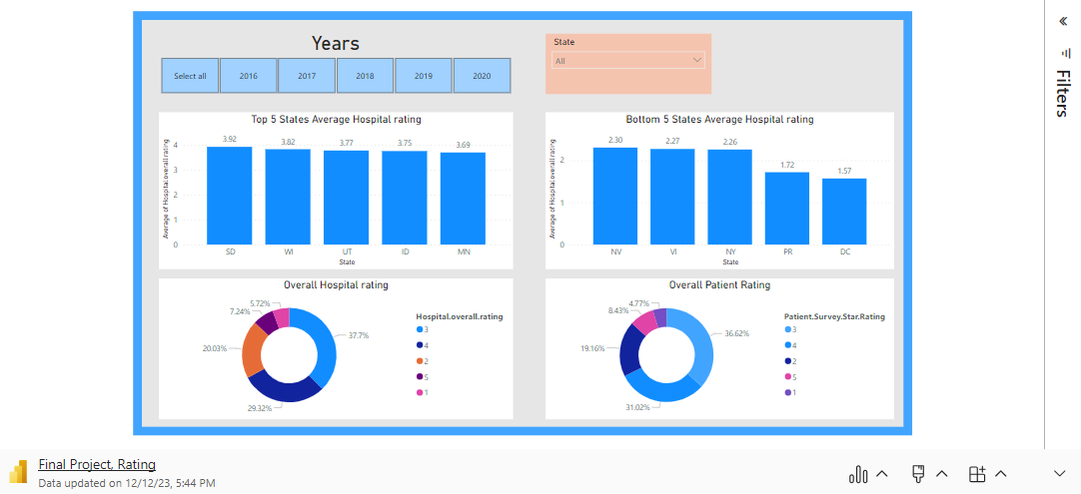
Exploratory Data Analysis

Slide 11
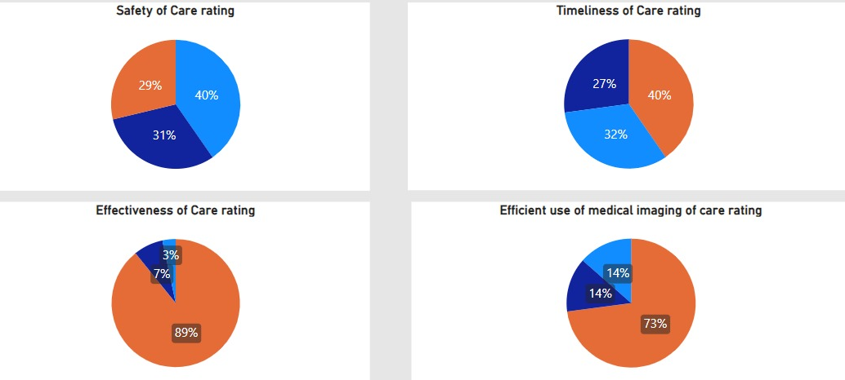
Exploratory Data Analysis
Above National Average
Same as the National Average
Below National Average

Slide 12


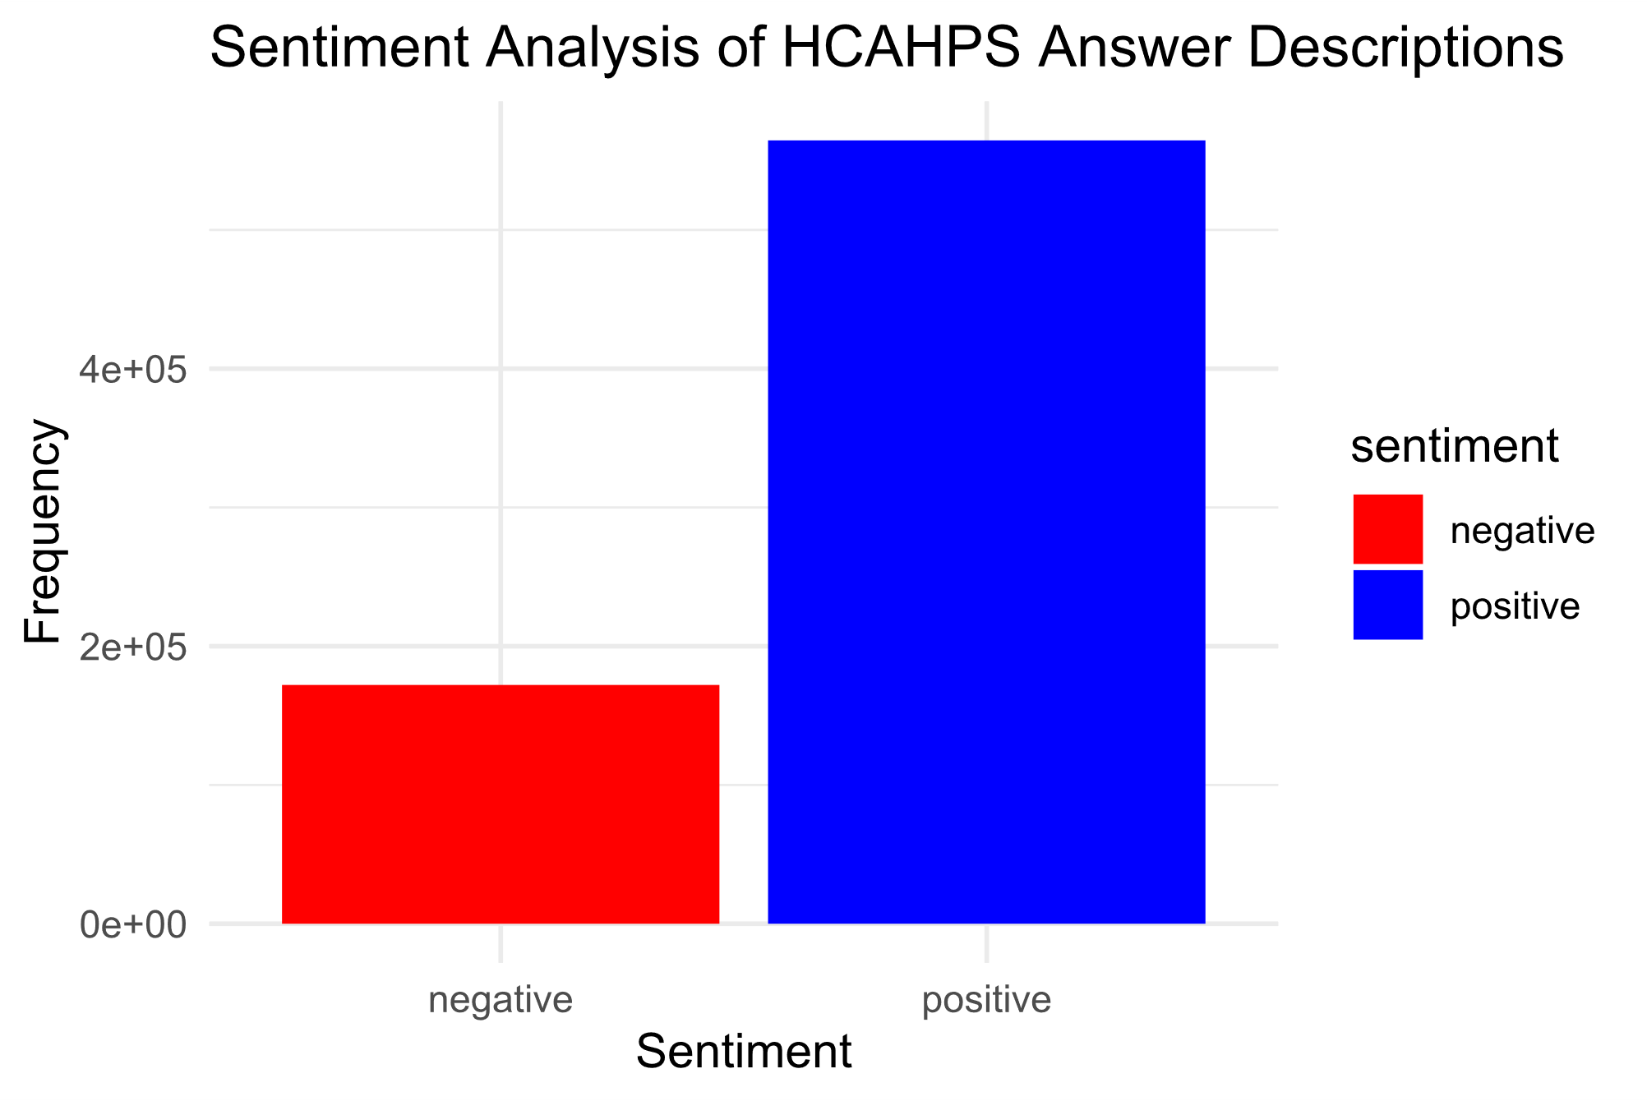
Text Analysis
HCAHPS Question Description
HCAHPS Answer Description
Keywords
Reported
Rating
Score
Star
Staff
Keywords
Rating
mean
Star
Staff
Communication

Slide 13
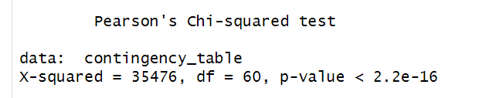
Statistical Modeling Saga
Is there any relation between the kind of ownership of hospitals and Patient star rating?
Ho: The type of ownership of the hospital does not affect patients' star rating which means score means are equivalent to each other
Ha: The type of ownership of hospital effects on patients' star rating which mean score means are not equivalent to each other
Chi-Square Test of Independence
Given the p-value is far less than 0.05, you would reject the null hypothesis (H0) that states the type of hospital ownership does affect patient star ratings
Notes:
Given that both your variables—ownership type and patient star rating—are categorical, and you are looking to test the independence between these two variables, a Chi-Square Test of Independence would be an appropriate choice. This test will help you determine if there is a significant association between the two categorical variables.
Given the p-value is far less than 0.05, you would reject the null hypothesis (H0) that states the type of hospital ownership does not affect patient star ratings. The test result suggests that there is a statistically significant association between the type of ownership of a hospital and the patient star ratings. So to conclude Type of ownership of hospital affects on patients' star rating

Slide 14
Conclusion
Most of the hospitals have been found to be located in East Coast
“Reported”, “Rating”, “Score”, “Care”, “staff”, and “communicated” are some key words found in text analysis
1
4
Health is Wealth
A positive correlation has been found between patient‘s overall rating and Hospital overall rating
Through sentiment Analysis of HCAHPS Answers, we could know the patients used more positive words to express satisfaction
2
5
The type of hospital ownership does affect patient star ratings
We could find a mixed rating when compared to national averages
3
6
"Empathy in Care, Healing in Experience: Redefining Healthcare Satisfaction"

Slide 15

Questions

Slide 16

Thank you

